Slide 1
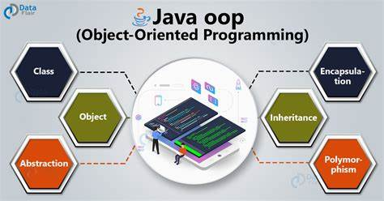
Object-oriented programming (oop152)

Slide 2
Access: Books / Eclipse ide / MS office…etc.

Slide 3
PRESCRIBED Textbook
Think Java: How to Think Like a Computer Scientist Downey, A.B. and Mayfield, C. (2019) Version 6.1.3

Slide 4
Topic 3 Objects

Slide 5
Objects
OUTLINE
Objects
Point Objects
Attributes
Point Objects as parameters
Objects as return types
Mutable Objects
Aliasing

Slide 6
objects

Slide 7
Objects
Objects:
Introduction to Point Objects
Part of the java.awt package, used to represent coordinates on a Cartesian plane.
Commonly used in graphical applications for positioning elements.

Slide 8
Objects
Objects:
Mathematical Representation
Points are typically denoted in mathematical notation within parentheses, e.g., (0,0) for the origin or (x,y) for other points.

Slide 9
Objects
Objects:
Importing the Point Class
To use Point, you must first import it from the java.awt package.
import java.awt.Point;

Slide 10
Objects
Objects:
Creating a Point Instance
Points are instantiated using the new operator.
Declare a Point variable and assign it a new Point object with specific coordinates.
Point blank;
blank = new Point(3, 4);
blank is a variable that holds a reference to the new Point object.
The new Point object is initialized with coordinates (3, 4).

Slide 11
Objects
Objects:
Understanding References and State Diagrams
The variable blank does not contain the Point object itself, but a reference to it.
State diagram visualization:
The variable name (blank) is shown outside a box.
Inside the box, a reference points to the object containing x and y values.
Example Diagram:
blank --> [Point object | x: 3, y: 4]

Slide 12
Objects
Objects:
Code Example
Demonstrating how to declare and instantiate a Point.
import java.awt.Point;
public class Main {
public static void main(String[] args) {
Point blank = new Point(3, 4);
System.out.println("Point coordinates: (" + blank.x + ", " + blank.y + ")");
}
}

Slide 13
attributes

Slide 14
Object
Objects:
Definition of Attributes
Variables that belong to an object are called attributes, also known as "fields.“
Attributes store data or state about the object.

Slide 15
Objects
Objects:
Accessing Attributes
Java uses dot notation to access an object's attributes.
Syntax: objectName.attributeName
Example:
int x = blank.x;

Slide 16
Objects
Objects:
Usage of Dot Notation
Access and manipulate object attributes directly.
Can be used within expressions to perform operations.
Example:
System.out.println(blank.x + ", " + blank.y);
int sum = blank.x * blank.x + blank.y * blank.y;

Slide 17
Objects
Objects:
No Conflict Between Local and Attribute Variables
Local variables can share the same name as an attribute without conflict.
Dot notation specifies which variable (attribute vs. local) is being referred to.

Slide 18
Objects
Objects:
Example in Context
Display the coordinates of a point and calculate the square of its distance from the origin.
Output:
Coordinates: 3, 4
Squared distance: 25

Slide 19
Objects
Objects:
Example in Context
Display the coordinates of a point and calculate the square of its distance from the origin.
Output:
Coordinates: 3, 4
Squared distance: 25

Slide 20
objects as parameters

Slide 21
Objects
Objects
Passing Objects:
Objects can be passed to methods as parameters, just like primitive data types.
Example: Passing a Point object to a method
public static void printPoint(Point p) {
System.out.println("(" + p.x + ", " + p.y + ")");
}

Slide 22
Object and classes
Objects
Utility of Passing Objects:
Enhances code readability and reduces errors.
Bundles related values (attributes of an object) together.

Slide 23
Objects
Objects
Using System.out.println:
Directly printing an object typically calls the object's toString() method.
Example output for a Point object:
java.awt.Point[x=3,y=4]
println automatically uses toString to get a string representation of the object.

Slide 24
Objects
Objects
Customizing Object Output:
Objects can override the toString() method to control what println displays.
Example: Point objects implement toString to display their type and attributes.

Slide 25
Objects
Objects
Practical Example with Point Objects:
Rewriting a method to use objects instead of multiple individual parameters:
public static double distance(Point p1, Point p2) {
int dx = p2.x - p1.x;
int dy = p2.y - p1.y;
return Math.sqrt(dx * dx + dy * dy);
}

Slide 26
Object and classes
Objects
Practical Example with Point Objects:
Output:
Point p1 = new Point(3, 4);
Point p2 = new Point(6, 8);
System.out.println(distance(p1, p2)); //5.0

Slide 27
objects as return types

Slide 28
Objects
Objects
Introduction to java.awt.Rectangle:
Part of the java.awt package, commonly used for graphical operations.
To use the Rectangle class, first import it:
import java.awt.Rectangle;

Slide 29
Objects
Objects
Creating a Rectangle:
A Rectangle object has four attributes: x, y, width, and height.
Example of creating a Rectangle object:
Rectangle box = new Rectangle(0, 0, 100, 200);
This code initializes box with coordinates at (0,0) and dimensions 100x200.

Slide 30
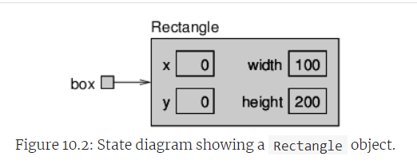
Objects
Objects
Understanding Rectangle State with Diagrams:
State diagrams can illustrate how objects are represented at a specific time.
Figure 10.2: Shows a state diagram of a Rectangle object.

Slide 31
Objects
Objects
Output of a Rectangle Object:
Using System.out.println(box) prints:
java.awt.Rectangle[x=0,y=0,width=100,height=200]
The println method internally calls the toString method of Rectangle, which formats the output.

Slide 32
Objects
Objects
Methods that Return Objects:
You can write methods that return new objects based on Rectangle attributes.
Example method to find the centre of a rectangle:
public static Point findCenter(Rectangle box) {
int x = box.x + box.width / 2;
int y = box.y + box.height / 2;
return new Point(x, y);
}
This method calculates the centre and returns a new Point object representing it.

Slide 33
Objects
Objects
Discussion Points:
How the Rectangle class can be utilized in graphical applications.
Implications of object references and object-oriented programming principles in Java.

Slide 34
mutable objects

Slide 35
Objects
Objects
Introduction to Mutable Objects
Mutable objects can have their attributes changed.
This allows for object attributes to be modified without creating a new object.

Slide 36
Objects
Objects
Example: Moving a Rectangle
Start with a rectangle defined as follows:
Rectangle box = new Rectangle(0, 0, 100, 200);
To move the rectangle without altering its size, adjust the x and y attributes:
box.x = box.x + 50;
box.y = box.y + 100;

Slide 37
Objects
Objects
Encapsulating Movement in a Method
Create a method to move the rectangle by any specified amounts (dx and dy):
public static void moveRect(Rectangle box, int dx, int dy) {
box.x = box.x + dx;
box.y = box.y + dy;
}
Example of using moveRect method
moveRect(box, 50, 100);
System.out.println(box);

Slide 38
Objects
Objects
Effect of Method Invocation
Invoking moveRect modifies the Rectangle passed as an argument.
This shows how objects can be modified by passing them to methods.

Slide 39
Objects and classes
Objects
Alternative with Built-in Methods
Java provides built-in methods such as translate for objects like Rectangle.
Using translate.
box.translate(50, 100);
This directly updates the object box using dot notation, similar to moveRect.

Slide 40
Objects
Objects
Object-Oriented Programming Insight
Prefer using object methods (like translate) to modify object state over external methods (like moveRect).
This promotes using dot notation, which is a clearer and more intuitive way of modifying objects.

Slide 41
aliasing

Slide 42
Objects
Objects
Introduction to Object References
Assigning an object to a variable actually assigns a reference to that object.
Multiple variables can refer to the same object, creating "aliases."

Slide 43
Objects
Objects
Example with Code:
Rectangle box1 = new Rectangle(0, 0, 100, 200);
Rectangle box2 = box1;

Slide 44
Objects
Objects
Explanation of Aliases
box1 and box2 are references to the same Rectangle object.
Changes made via one alias affect the object referred to by the other.

Slide 45
Objects
Objects
Code Demonstration: Changing Object Dimensions
System.out.println(box2.width); // Outputs 100
box1.grow(50, 50); // Grows the rectangle
System.out.println(box2.width); // Outputs 200

Slide 46
Objects
Objects
Detailed Explanation of Code Behaviour:
Initial width of the rectangle referred by box2 is 100.
box1.grow(50, 50) increases both height and width by 100.
As box1 and box2 refer to the same object, changes are visible via box2

Slide 47
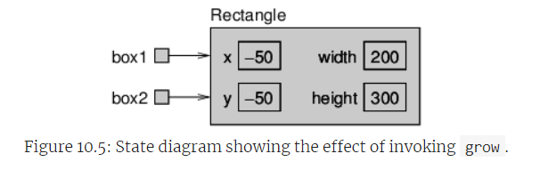
Objects
Objects
Visual Representation:
Include state diagrams showing how both variables refer to the same object and the effect of invoking the grow method.

Slide 48
Objects
Objects
Conclusion on Object References:
Understanding that variables hold references, not actual objects, is crucial.
This behaviour enables linked changes across all references to an object.

Slide 49



